Slide 1

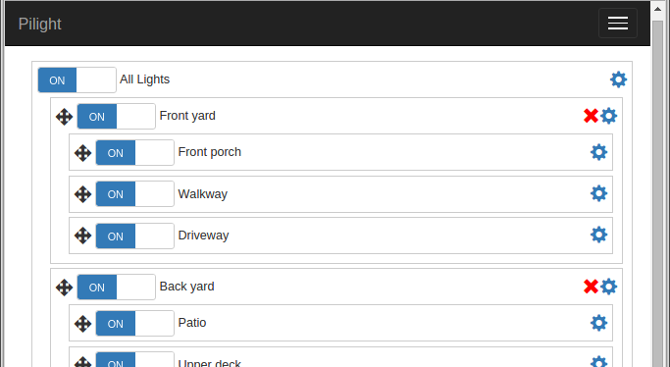
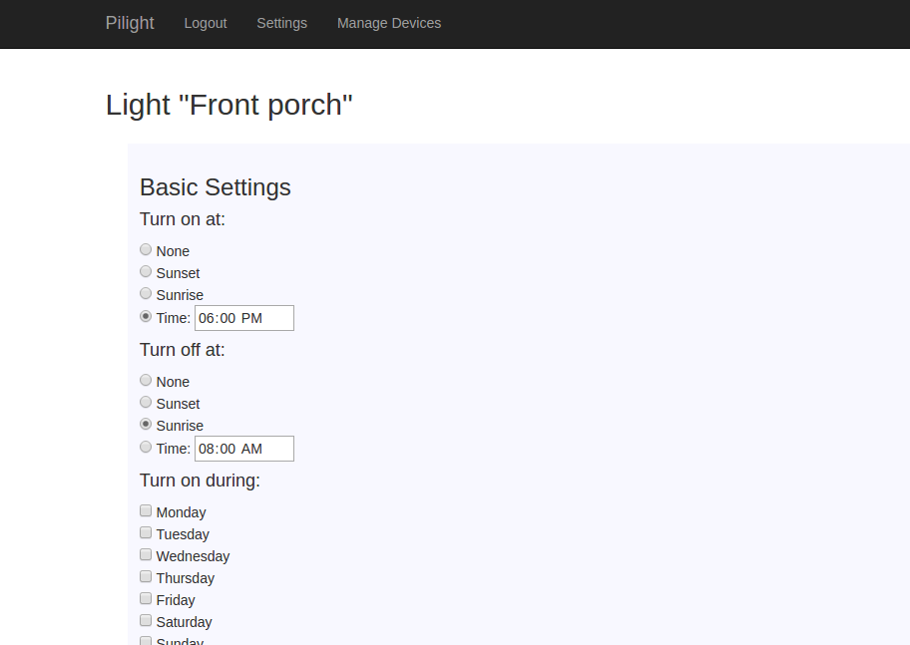
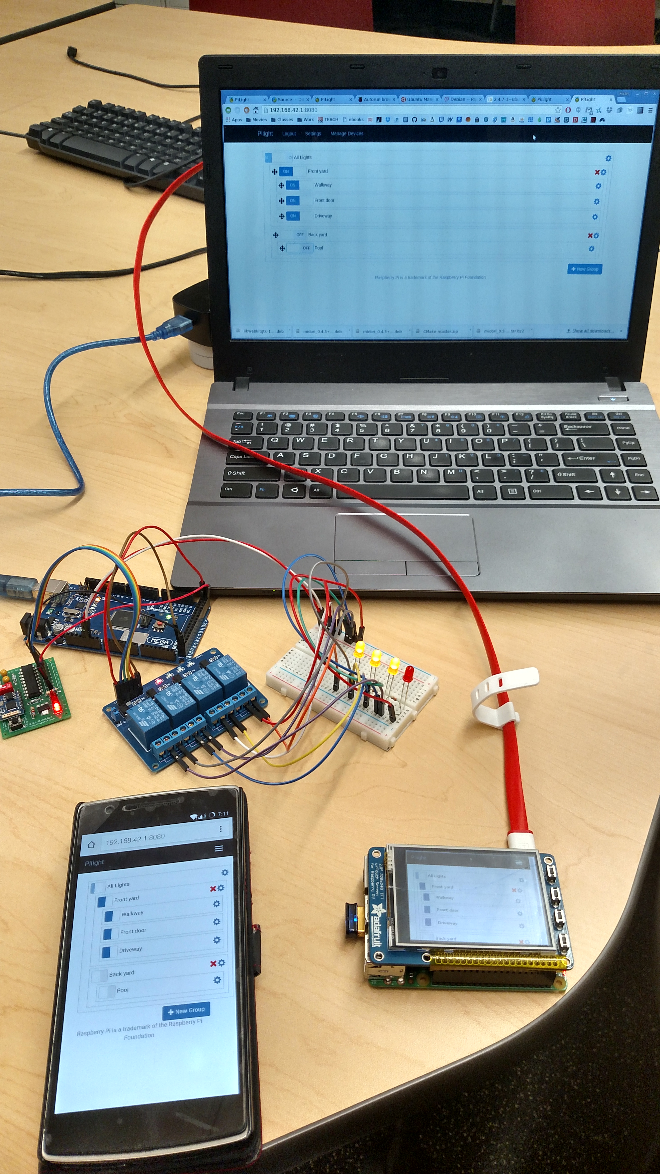

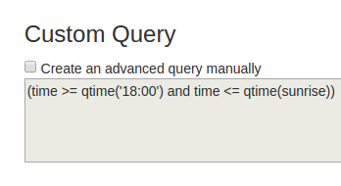
PiLight “Not Exactly the Internet of Things” for Home Lighting
Approach Taken
Our primary goal for PiLight was ease of use, so we designed a simple front page with clickable switches for each light. The interface is available on the control unit’s touchscreen for quick reference, as well as any phone, tablet, or laptop. Easy setup was also important, so all devices communicate wirelessly. Users can plug their lights into the strips, connect them to power, press the pairing button, and the control unit will pair up and allow users to toggle and program their lights.
CS Capstone Project Team 22
Solution Implemented
Plug lights into strips
Connect the light strips to power
Connect the control unit to power and press the “pair” button
All components connect wirelessly
Use touchscreen for toggling lights
Also control from phone, laptop, etc.
Lights can be set to toggle at sunset/sunrise automatically
Open source software
Inexpensive, easy to use, extensible
TEAM MEMBERS
Malcolm Diller (dillerm@oregonstate.edu)
Sean Rettig (rettigs@oregonstate.edu)
Evan Steele (steelee@oregonstate.edu)
PROJECT ADVISOR
Victor Hsu (hsuv@oregonstate.edu)
PROJECT SPONSOR
OSU
Main interface as seen on a laptop. Clicking a switch toggles the light (or group of lights) on or off.
Project Description
The options on the market today for home lighting control are less than ideal. You can either pay out the nose for an overly-complex system that might get shut down in a few years, or be stuck with a cheap system that needs constant reprogramming for the changing sunset and sunrise times.
Our goal is to split the difference by providing a solution that is both easy to use and affordable. The solution includes a central control unit with a touchscreen for controlling lights, a web site for controlling the entire system from a phone, laptop, tablet, or other device, and power strip devices to plug lights into that communicate with the central control unit wirelessly.
Running on commodity hardware and open source software, the system is inexpensive and easy to extend to other applications as well, such as garage door openers, sprinkler systems, and more!
Results and Recommendations
The PiLight interface is functional across all supported devices, including laptops, phones, and the Pi itself (the central control unit). Lights can be fully controlled both manually and through the comprehensive rule system that is both easy to use and highly customizable.
Our work has resulted in a low-cost way to implement automation systems for home lighting.
Light automation settings as seen on a laptop. A simple interface let users create “rules”, which decide when a light should be on or off. An advanced interface is also available.
Solutions Considered
Wired connections; these would be too difficult to set up
Non-touchscreen device; this would require lots of tiny buttons, making the interface difficult to use
Ad-hoc networking; this was not feasible with our hardware and made connecting via a phone or laptop difficult, so we went with Wi-Fi and a device pairing system.
Showing the main interface on a laptop, a phone, and the control unit (Raspberry Pi, lower right). Also shown is the hardware for a light strip, including a relay (blue), four connected LEDs on a breadboard (right of relay), and the ESP8266 Wi-Fi module (green, left of relay). An Arduino Mega is used as a power supply (above relay).

